Slide 1
UAV interface development for countering unidentified drones
Team. Beer per Day
Shinhyoung Jang, Byeonghwi Park, Juheon Jeong (Chungnam National University)
Jack Mahedy, Nebey Gebreslassie (Purdue University)

Slide 2
Contents
Introduction
Related Works
Methodology
Future Plans

Slide 3
INTRODUCTION
TEAM, ACRONYM, and PROJECT GOAL

Slide 4





Introduction
Team Introduction
Shinhyoung Jang
Computer Science & Engr.
Chungnam Nat’l Univ.
Team Leader
Byeonghwi Park
Computer Science & Engr.
Chungnam Nat’l Univ.
Research & Developer
Juheon Jeong
Computer Science & Engr.
Chungnam Nat’l Univ.
Research & Verifier
Jack Mahedy
Computer & Information Tech.
Purdue Univ.
Research & Developer
Nebey Gebreslaassie
Computer & Information Tech.
Purdue Univ.
Research & Verifier

Slide 5
Introduction
Acronym
UAV : Unmanned Aerial Vehicles
TSPI : Time Space Position Information
Coordinate : set of Latitude, Longitude, and Altitude
Trajectory : drone’s flying path
SDK : Software Development Kit
LSTM : Long Short-Term Memory

Slide 6
Introduction
Project Motivation
UAVs have a variety of usages and are used in a multitude of settings such as military use
- In the 2022 Russian invasion of Ukraine, UAV takes part in and strike other territories to destroy the installation^{[1]}
- In 2022 North Korean drone invasion of airspace in South Korea– North Korea, on January 3rd, 2023, North Korea UAV entered the no-fly zone, but South Korea didn’t detect with their RADAR systems^{[2]}
⇒ UAVs and the detecting UAV systems are becoming more important in Military
[1] S. Rosenberg and J. Lukiv. “Ukraine war: Drone attack on Russian bomber base leaves three dead.” https://www.bbc.com/news/world-europe-64092183 (accessed Jan. 11, 2023).
[2] J. Kwon and S. Jeong, I. Kottasova and J. Yeung “South Korea fires warning shots after North Korean drones enter its airspace.” https://www.cnn.com/2022/12/26/asia/north-korean-drones-south-airspace-intl/index.html (accessed Jan. 11, 2023).

Slide 7
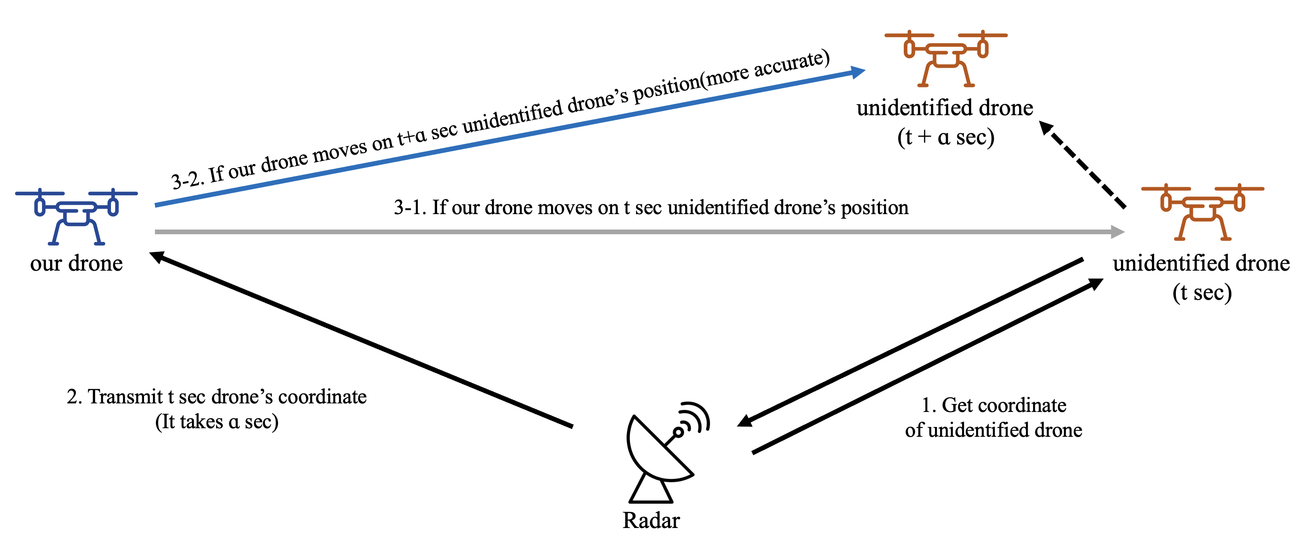
Introduction
Project Goal
Making UAV interface for countering dangerous or terroristic drones
Due to the transmission delay, our drone can’t reach an unidentified drone
So, this research suggests predict the unidentified drone’s coordinate

Slide 8
RELATED WORKS
RELATED TO THE PROJECT’S GOAL

Slide 9
Related Works
Calculating spatial coordinates
Radar system extracts an objects’ coordinates
Shin et al.^{[3]} proposed relative coordinates from the radar are converted to absolute coordinates
After this, They conducted to convert absolute coordinates into the relative coordinates of other objects
In order to conduct this, they used the formula for rotation matrix and transpose matrix with Cartesian coordinates
[3] Shin, et al. The Study on Coordinate Transformation of the Tracking Radar in NARO Space Center, 2011, v10, no.1, pp. 116-121, Aerosp. Engineering and Tech.

Slide 10
Related Works
Relation between past TSPI and trajectory prediction
Ziyu Zhao^{[4]} et al. focused on aircraft trajectory prediction using deep learning with Trajectory Change Point (TCP)
TCP is created by using a trajectory clustering algorithm and analyzing the relationship between meteorological information such as distance, temperature and past data which include location and velocity
[4] Ziyu Zhao, et al. A Deep Learning Approach for Aircraft Trajectory Prediction in Pre-Tactical Stage, 2022 5th Int. Symp. on Autonomous Systems(ISAS)

Slide 11
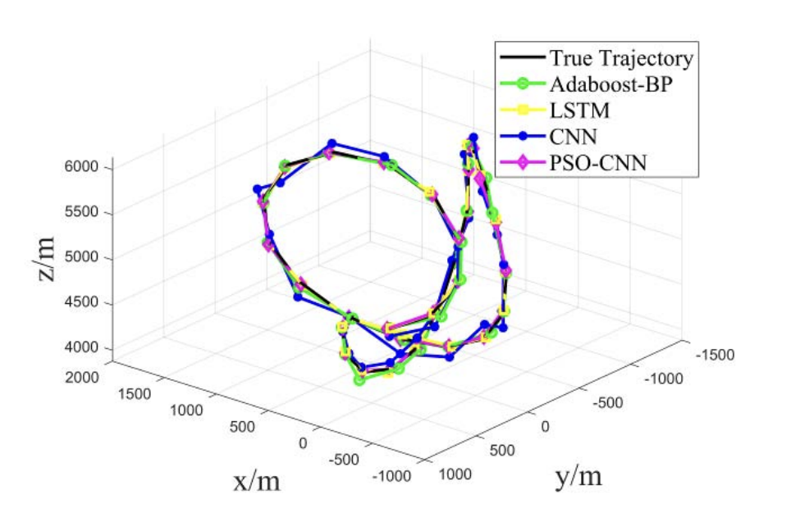
Related Works
Relation between past TSPI and trajectory prediction (Cont’d)
In Xie Lei^{[5]} et al. research, Unmanned Combat Aerial Vehicle (UCAV) maneuvering trajectory was predicted with particle swarm optimization-CNN (PSO-CNN)
The spatial coordinates can be derived by computing the equation about control variables
PSO-CNN avoid “gradient disappearance” problem, because it uses a heuristic optimization algorithm to transform the weight update into an optimization problem
Compared to other methods such as LSTM, Adaboost-BP and CNN, the method used in the paper produced better performance
Figure 1. 3D trajectory prediction view
[5, Fig 1] Xie Lei, et al. UCAV maneuvering trajectory prediction based on PSO-CNN, 2021 Int. Conf. on Computer Engineering and Application(ICCEA)

Slide 12
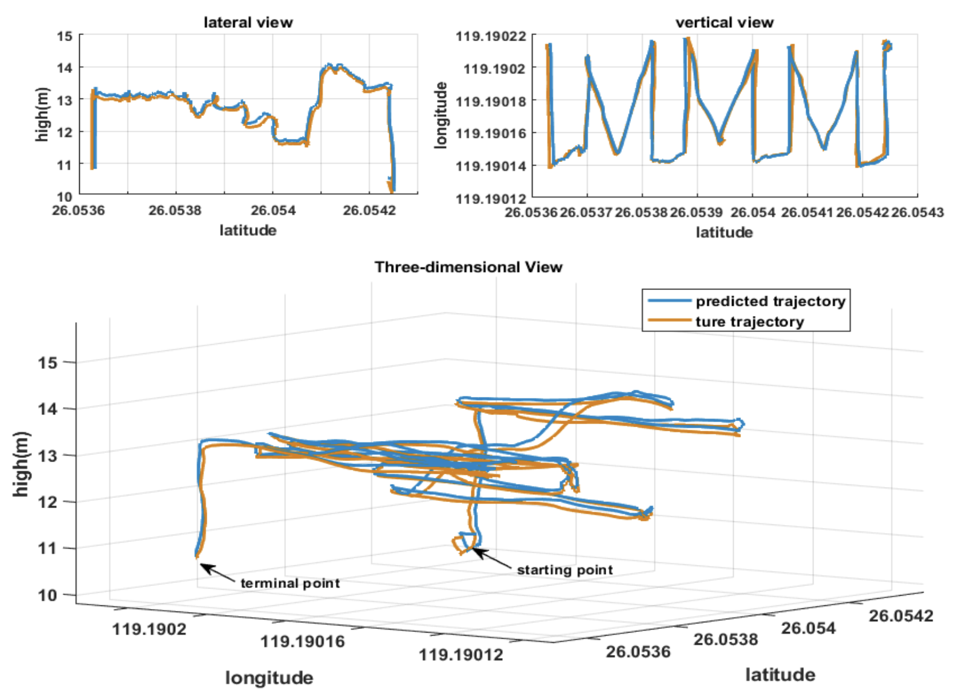
Related Works
Relation between past TSPI and trajectory prediction (Cont’d)
In Peng Shu^{[6]} et al. research, the UAV trajectory prediction based on LSTM, which uses coordinate information, is meaningful
Also, Stacked Bidirectional and Unidirectional LSTM(SBULSTM) has good performance in the real UAV cruise scenario
Figure 2. Lateral view, Vertical view and Three-dimensional view of predicted trajectory and true trajectory
[6, Fig 2] Peng Shu et al. Trajectory prediction of UAV Based on LSTM, 2021 2nd Int. Conf. on Big Data & Artificial Intelligence & Software. Engineering (ICBASE).

Slide 13
METHODOLOGY
FLOW CHART, ALGORITHM

Slide 14
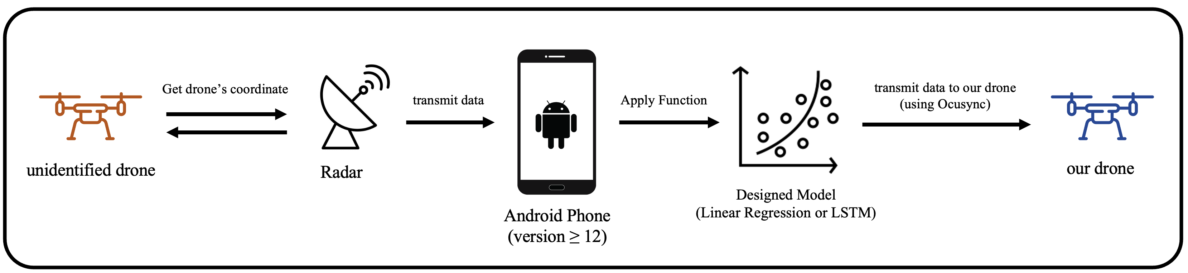
Methodology
System Flow chart
(version ≥ 12.0)
Radar detects unidentified drone and get its coordinate
Radar transmits data to Android Phone
S/W predicts next coordinate with Designed Model and data
Transmit data to our Drone
Notes:
Ok, I’m Shinhyoung at team beer per day.
Now I’ll start methodology of our experiment.
First, the unidentified object show up In the sky.
Radar will detect its location. But, only with location we cant judge it is drone or not.
So, we use trajectory predictioin model to forecast the next spatial coordinates of target.
After the prediction, the other UAVs fly to target drone. And it will chase it to be closer.

Slide 15
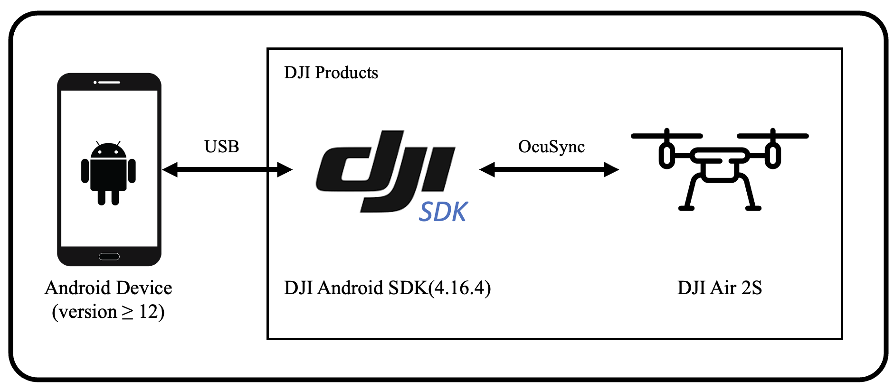
Methodology
System Architecture & Requirements
(version ≥ 12.0)
Prepare Android Device (version ≥ 12.0)
Prepare DJI Drone which can use DJI Android SDK version 4 (We used DJI Air 2S)
Mount DJI Android SDK (version 4.16.4) on Android Device
Notes:
As we are using DJI drone as a target product,
DJI supports mobile SDK to build interface that interacts with their aircraft.
In here, we use the latest version of android SDK.
It works as a Importing the SDK to our android project.

Slide 16
Methodology
Dataset Collection
(version ≥ 12.0)
Modify method which is getting GPS data only 1 to several times at specific intervals
Fly drone as mush as possible & collect dataset
(Use different flight routes, such as 8 shape, Z shape, L shape for a diverse dataset)
Notes:
When building the interface, the main point is pulling out the data from the drone.
As an API, there is a callback function that triggered when the aircraft’s state has changed, or in a specific time interval.
It was hard to modify the original function.
We decide to make a new thread that runs every 1 second to get a location and speed of UAVs.
Now we plan to use a simulator or real test, to collect data of drone.

Slide 17
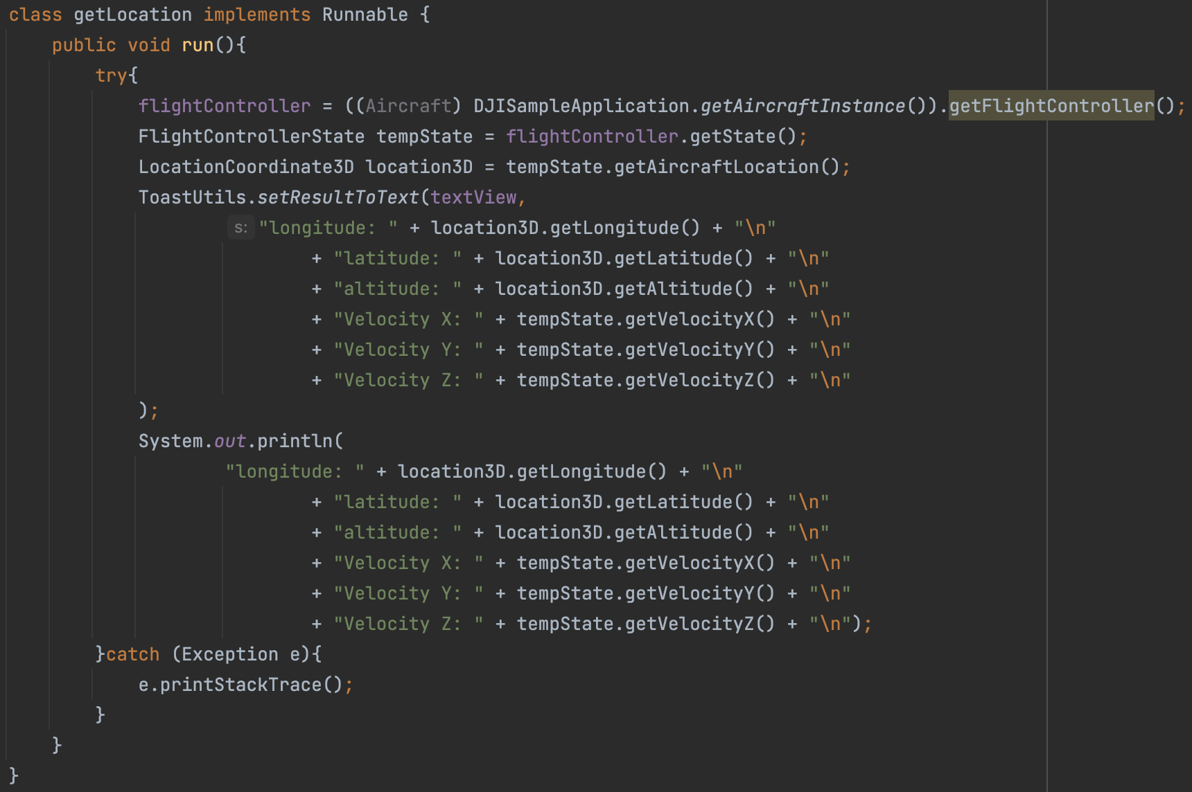
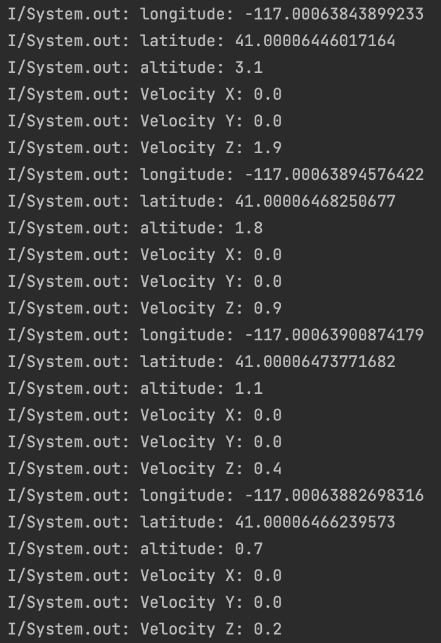
Methodology
Making SDK functions for communicating to drone from Phone
Android SDK code of extract data (time interval : 1 sec)
Result of extract data
Notes:
With the left picture, we implement a thread which excuted 1 sec period.
It leave a log where the aircraft now exists.

Slide 18
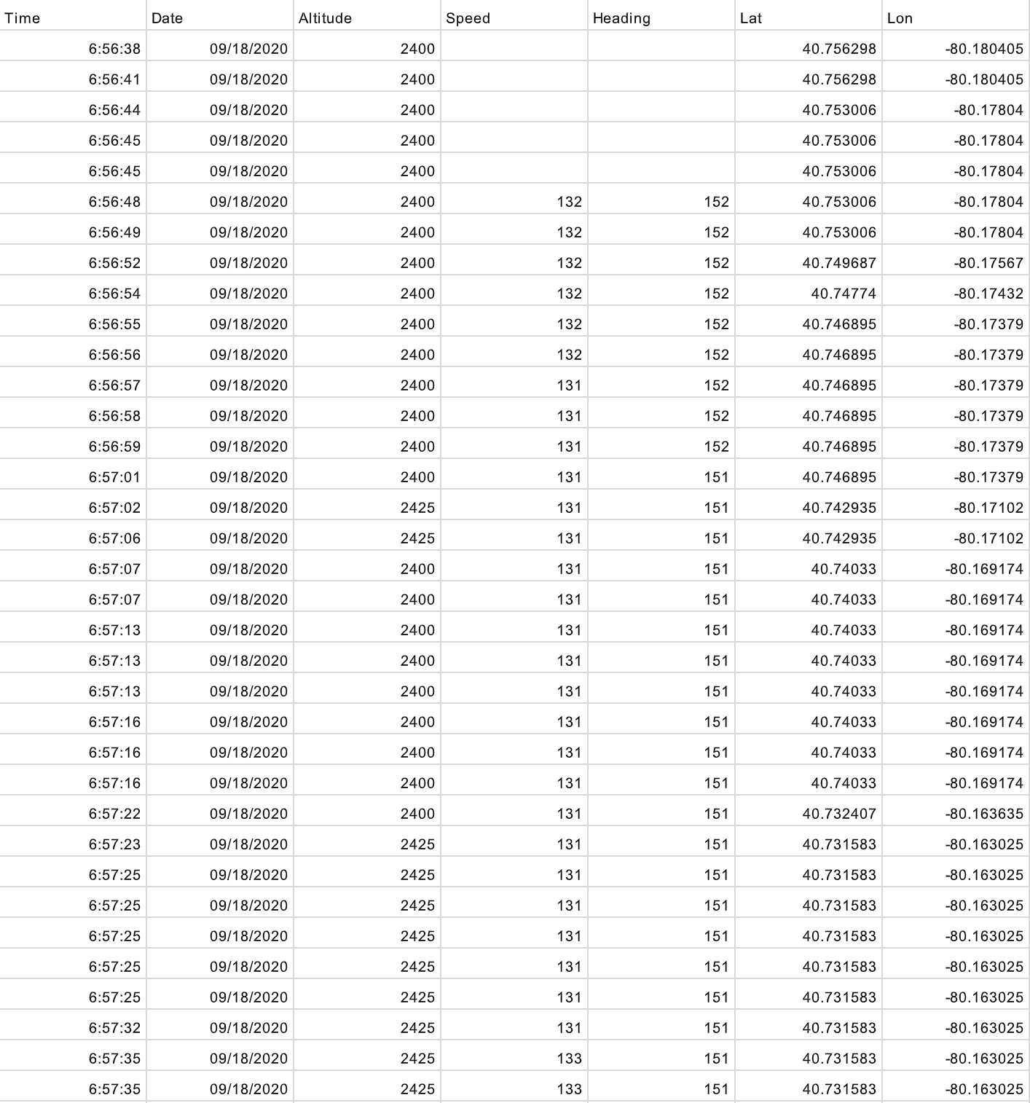
Methodology
Verify Machine Learning Algorithm
Utilized aviation GPS dataset (longitude, latitude, altitude)
- Due to similar trajectories aviation data was used
Data preprocessing (such as same time, time interval)
[7] Patrikar, Jay; Moon, Brady; Ghosh, Sourish; Oh, Jean; Scherer, Sebastian (2021): TrajAir: A General Aviation Trajectory Dataset. Carnegie Mellon University. Dataset. https://doi.org/10.1184/R1/14866251.v1 )
Notes:
And now we want to verify the prediction model works well.
We search the data of aviation trajectory and get the dataset from Carnegi Mello University.
When you see the time column, there interval doesn’t look like repeat at the same time.
We preprocessed those data to formed in a good interval.

Slide 19
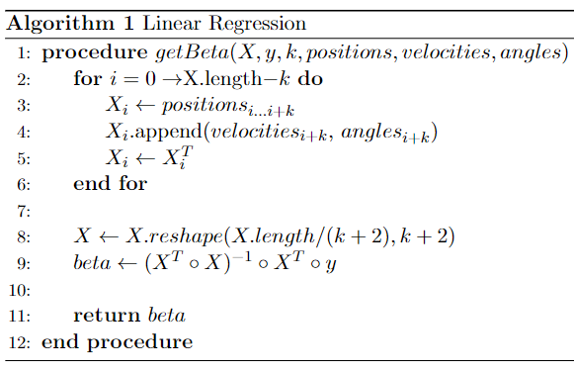
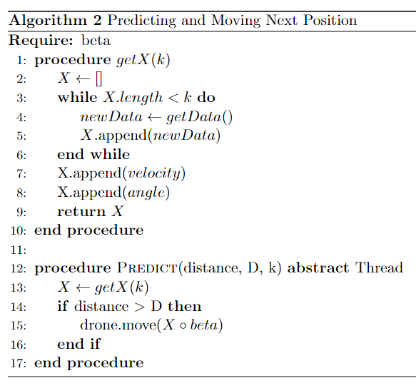
Methodology
Making Algorithms for Linear Regression
Notes:
It is our sudo code of Linear Regression model and predicting algorithms.
As a main feature, we care about location, velocity, and angle.
At the last, implement formula that calculating the beta.
We thought trajectory is predictable when you get a sequential data.
So model predicts when you have a sufficent data more than the requirement.

Slide 20
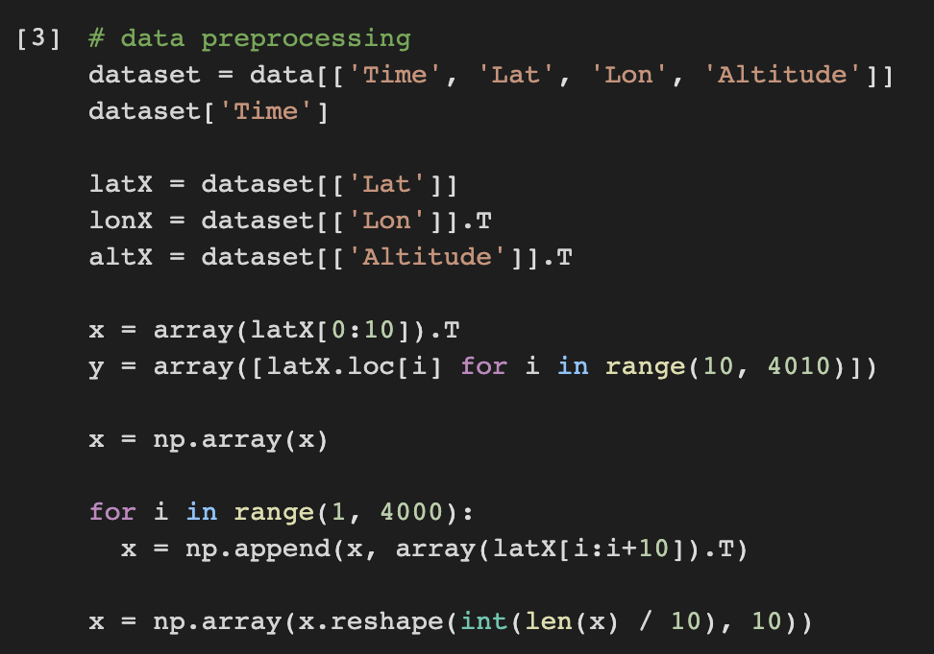
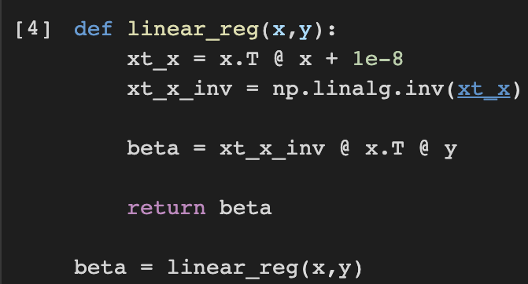
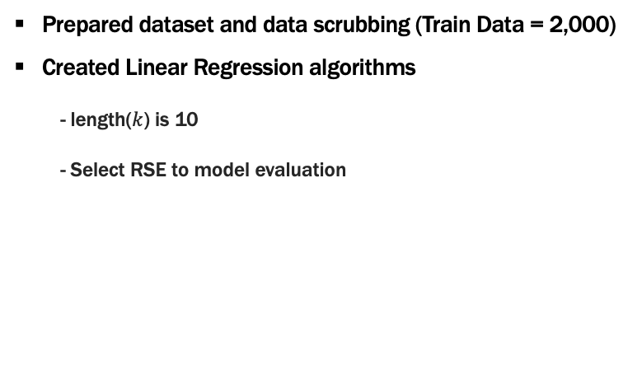
Methodology
Verify Machine Learning Algorithm – Linear Regression
Prepared dataset and data scrubbing (Train Data = 2,000)
Created Linear Regression algorithms
- length($k$) is 10
- Select RSE to model evaluation
Notes:
After the preprocess, the whole 18,600 data decreases to 8,600.
In the first step, we divide data set to 4,000 to train data, 4,600 to test data.
At the result, loss of train was good. But, test result was bad.
We thought overfit is the reason.
And we choose to use less train data. So here 2,000 to train data.
To consider as a sequential, time series data, every row has 10 columns and it contains location.

Slide 21
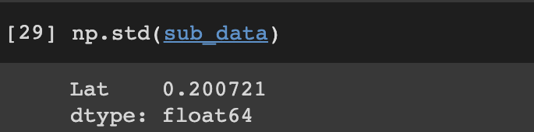
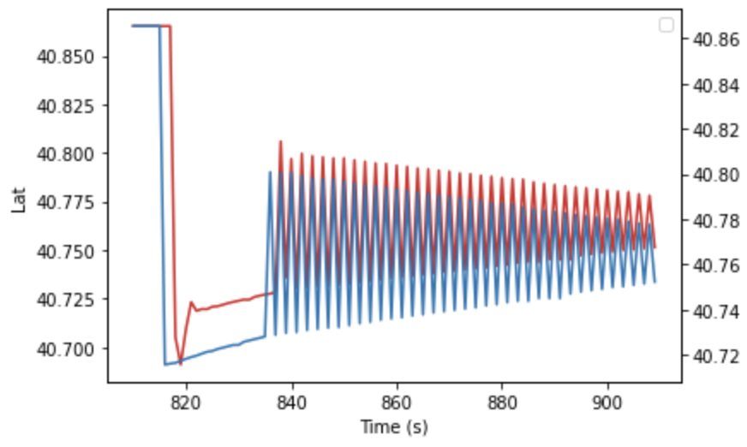
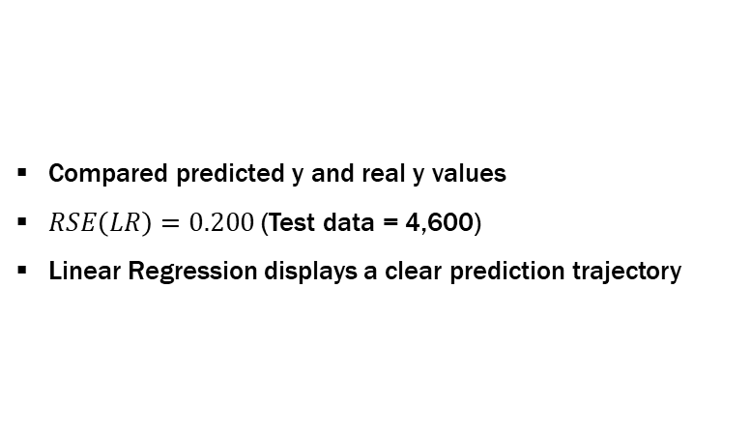
Methodology
Verify Machine Learning Algorithm – Linear Regression(Cont’d)
Compared predicted y and real y values
$RSE\left(LR\right)=0.200$ (Test data = 4,600)
Linear Regression displays a clear prediction trajectory
Notes:
Now when you see the graph.
Blue line shows real data and red one is prediction.
I would say it describes the tendency of original data.

Slide 22
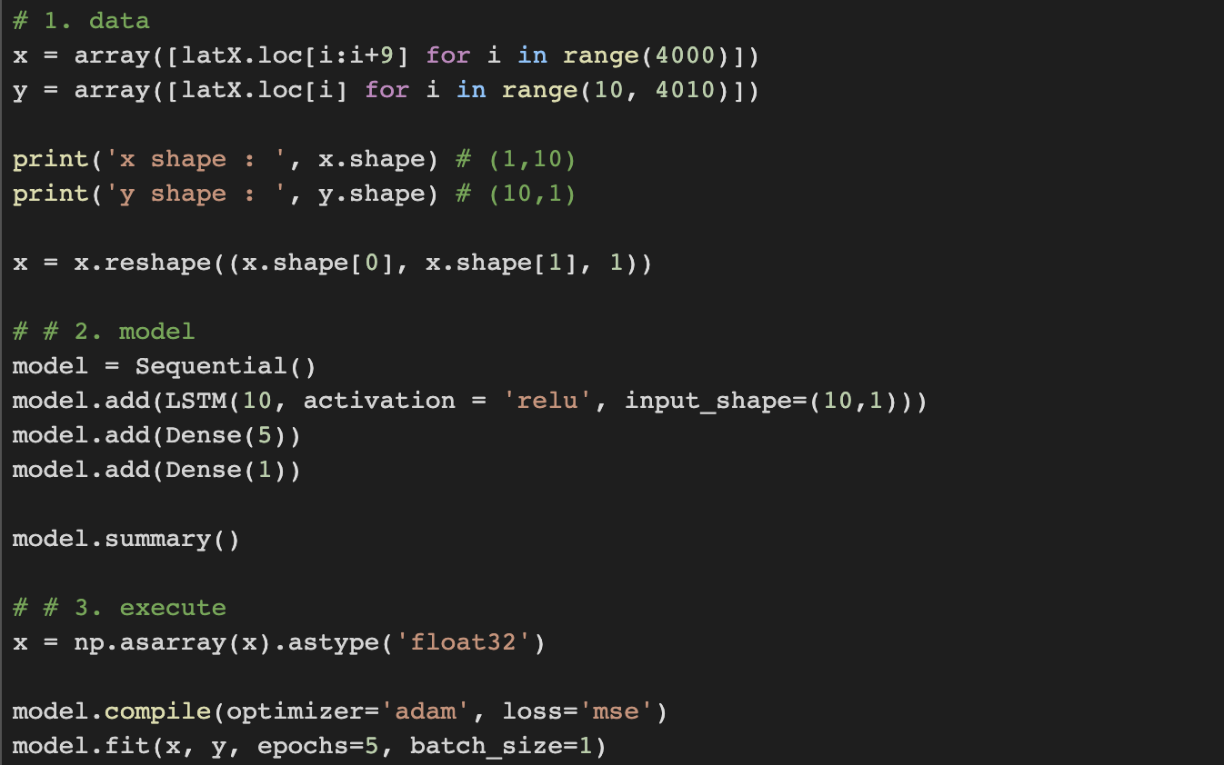
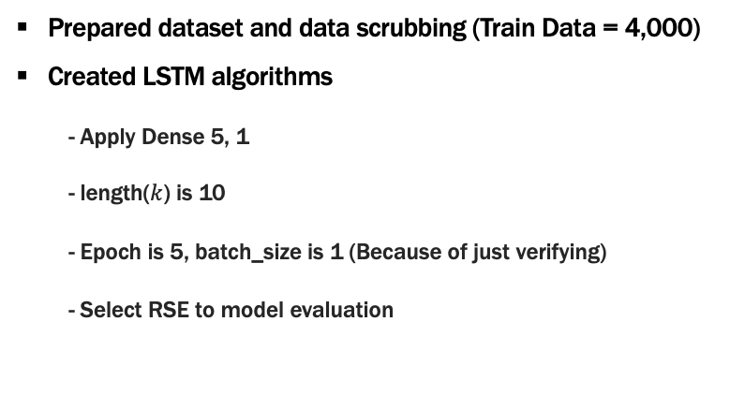
Methodology
Verify Machine Learning Algorithm – LSTM
Prepared dataset and data scrubbing (Train Data = 4,000)
Created LSTM algorithms
- Apply Dense 5, 1
- length($k$) is 10
- Epoch is 5, batch_size is 1 (Because of just verifying)
- Select RSE to model evaluation
Notes:
And we use same data to LSTM.
4,000 train data works well on LSTM.
Applying the dense as 5, 1 is the LSTM’s output has 10 data.
And it need to be narrow down to 1 output.
Dense layer transform the output with the activation function.
And we give length as a 10, of course it is for making data as a time series.

Slide 23
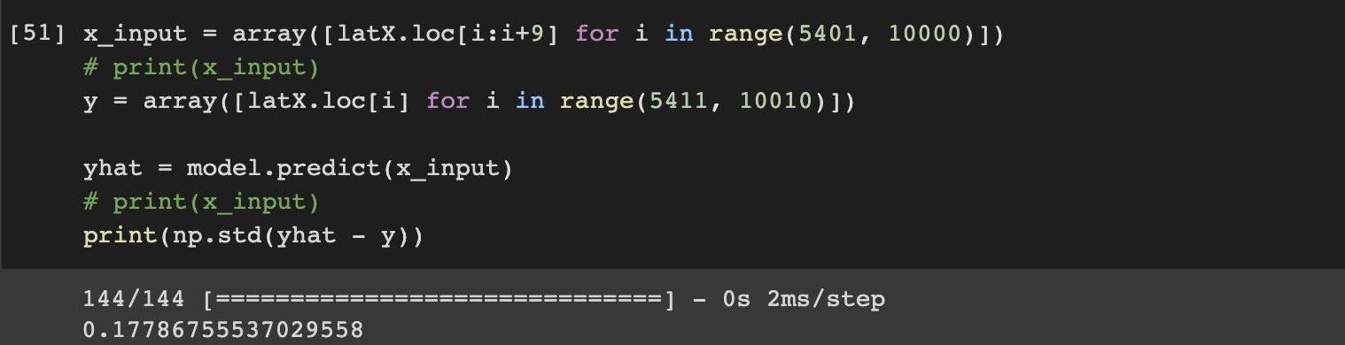
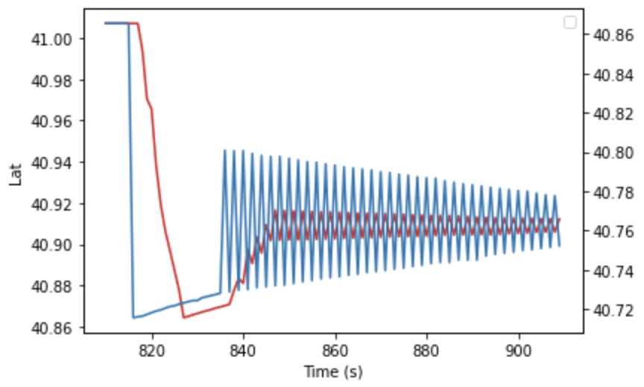
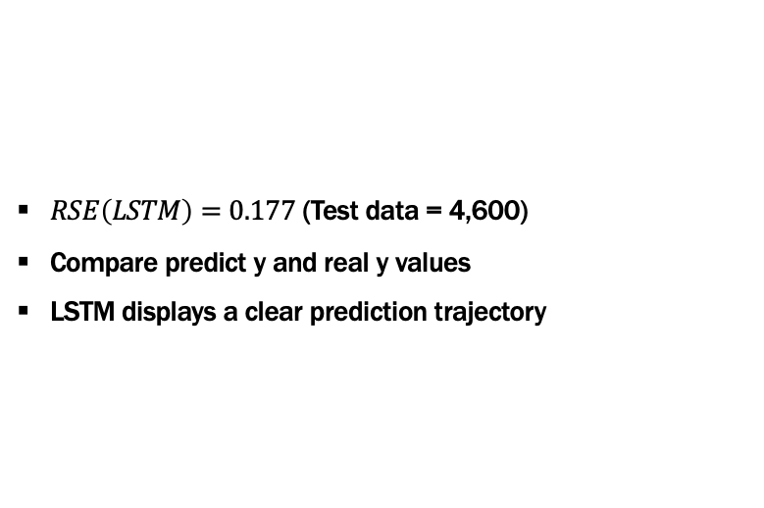
Methodology
Verify Machine Learning Algorithm – LSTM(Cont’d)
$RSE\left(LSTM\right)=0.177$ (Test data = 4,600)
Compare predict y and real y values
LSTM displays a clear prediction trajectory
Notes:
When you see the figure here.
LSTM’s prediction narrow down to one point.
It doesn’t follow the tendency, but in the end it will be give the same point.

Slide 24
FUTURE PLAN
PROJECT’S NEXT STEPS

Slide 25
Future Plans
Future Plan
▪ Making Wi-Fi connection from phone to the other device
▪ Implementing waypoint algorithm to chase the target drone
▪ Comparing ML codes with various performance models (RSE, MSE, and so on)
▪ Collecting data with variable trajectory shape
Notes:
About the future plan,
Our next step is making a Wi-Fi connection which are from android to CPU or more device.
The next will implement an automatic waypoint mission creator.
Which means if we have a predicted location the drone flys to destination with auto pilot.
Additionaly,
We plan to compare performance of trajectory predicting model.
And get a insight that which model will be fit on our system.
And the last, collecting data which has variable trajectory shapes.

Slide 26
Thank You
Team. Beer per Day
Shinhyoung Jang, Byeonghwi Park, Juheon Jeong (Chungnam National University)
Jack Mahedy, Nebey Gebreslassie (Purdue University)

